Slide 1


BeFriends
DIPP74781
India’s FIRST Community powered and AI backed Mental Health Support Application
HAZHTeq Innovations Pvt Ltd

Slide 2
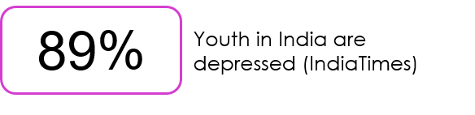
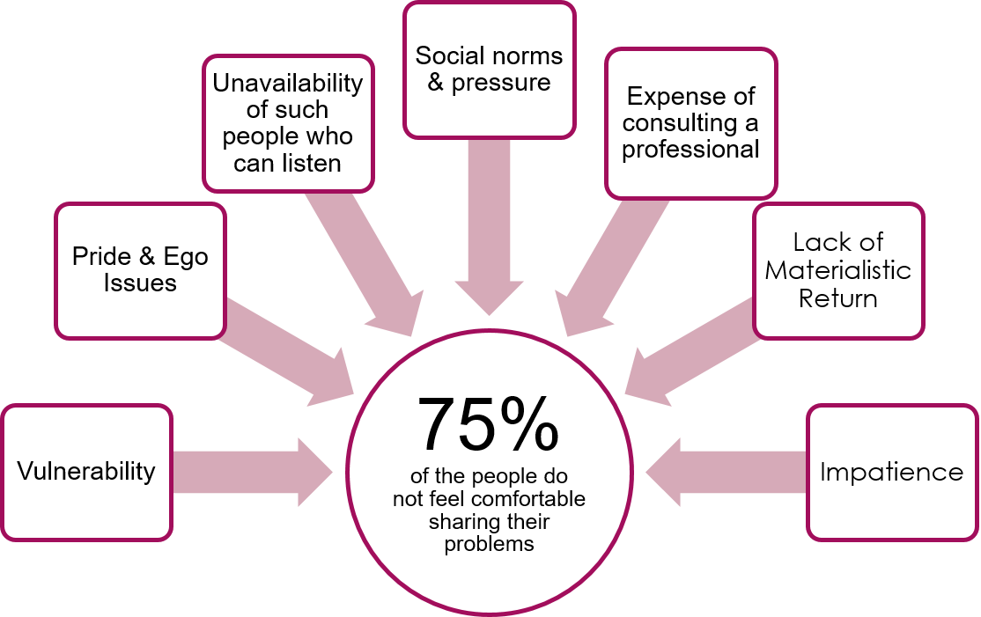
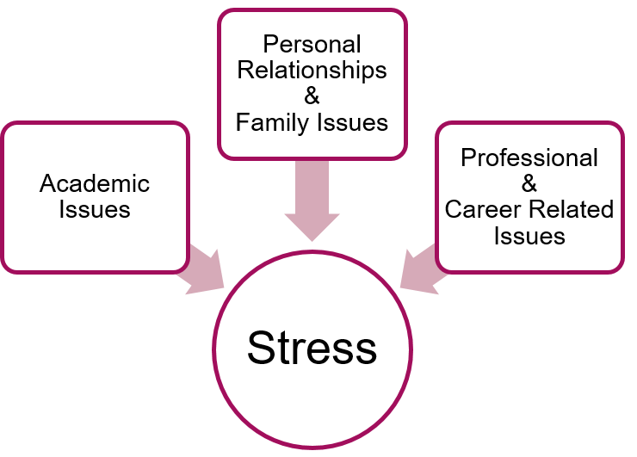
Problem

Slide 3
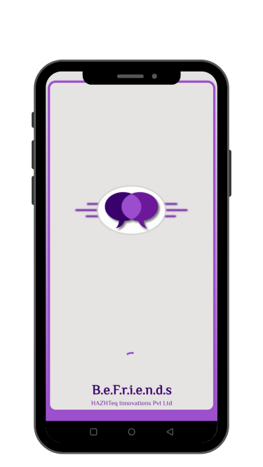
Solution: BeFriends
Anonymity of Users
U2L chat + Forum
Diary Writing
Mood Analysis
Personality Assessment
Mood Elevating Content
Store
AI Assistant
Consultations with Experts

Slide 4
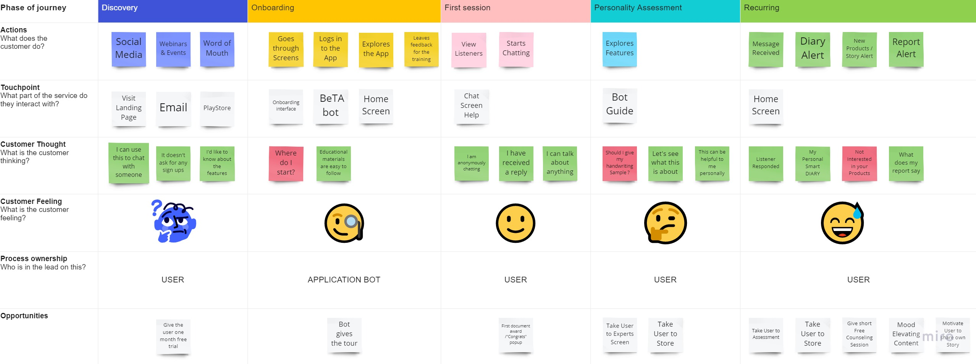
How Does It Work?

Slide 5
TAM
SAM
5.02%
13.4%
Compound Annual Growth Rate
Compound Annual Growth Rate
~$24.9 Bn
2017
~$1.6 Bn
in 2019
People are going through Mental Health Disorders(WHO)
792Mn
150Mn
People need active intervention
(WHO)
Employees of Corporate Sector Suffer
(Diplomat)
42.5%
People are suffering from Depression
(WHO)
322Mn
~371
People in India attempt suicide, DAILY
Indians Suffer from different stages of Depression
(Diplomat)
667%
Increase in Mental Health Keywords Searches in Last Year
>43%
People are suffering from Anxiety Disorders
(WHO)
284Mn
~$242 Bn
by 2030
~$2.57 Bn
by 2023

Slide 6
Value Proposition
Anonymity | No Need to Reveal Identity No Fear of Vulnerability; No Judgement
User-to-Listener Chat | No bots; No charges for chatting with a Listener Safe and Comfortable Chat Platform instead of Video Call/Call
Diary Writing + Mood Analysis | Track record for user’s emotional well being Helpful in Counseling
Analytical Based Counseling | Personality Trait Report based on Handwriting, before the Consultation which saves time and money
Mood Elevating Content | Instant Help to Try and Make you Smile and uplifting your mood
Store | Self Help Materials on your finger tips
AI Assistant | BeFriends Technical Assistant at your Service

Slide 7
Competitors
Features | BeFriends | YourDost | TalkToAngel | 7Cups | Innerhour | Aurum
Anonymity of the user | ✔ | ✔ |  | ✔ |  | ✔
Emotion and Mood Analysis | ✔
Friendly Listeners | ✔ |  |  | ✔
Assessment Based Counseling | ✔
Expert Consultancy | ✔ | ✔ | ✔ | ✔ | ✔ | ✔
Mood Elevating Content | ✔ | ✔ (Blogs) |  |  | ✔ (Blogs) | ✔ (Blogs)
Self Help Materials | ✔ | ✔ (Videos) |  |  | ✔ (Videos)

Slide 8

Revenue Model
Premium
Ads
No Ads
Monthly Counseling Session
Store
Commission
Online Store for Self Help Materials.
Aroma Therapy Blends and Diffusers
20% of the Fees from the Counselor

Slide 9
Roadmap
Incorporated
Dec18
Team
Apr19
Our Vision
A World Where Talking About Mental Health Is Not Frowned Upon Or Taken Lightly.
Idea Inception
Nov18
Pilot App
Jan19
Roping in
Professionals
Feb20
Website
Launch
Dec19
App Launch
July20
Conducted
Webinars and Talks
Sept20
Incubated
at MSU
Dec20
Real Life
Warriors
Mar21
NOW
Setting up
E-Com Store
Sep21
Market
Presence
Feb22
Our Mission
To Provide Support To People Struggling Through Their Lives, Ensuring Well-being Of Our Users, And Help Them Develop Themselves.
B2B
Apr22
Product
Development
Sep21
Robot Pet
Development
March22

Slide 10
In Numbers
300+
70K+
75+
5000+
10
Analysis
INR Revenue
Counseling sessions
Website Visitors
Counselors
500+
15
25
11
20
Downloads
DAU
Daily Interactions
Listeners
Subscriptions

Slide 11
Investment
Funding Ask:
  2 Cr INR
Bootstrapped Amount : 3,00,000* INR
Exit Strategy
  Our aim is to build a sustainable, and stable business with a steady revenue stream, with this we aim to buy out the stake of our early investors to keep the business running, in the time span of 5-7 years with aim of 3-5x Returns
  We will surely keep an eye for Merger and Acquisitions after we have met our designed milestones, to cash out and pay our early investors.
Justification

Slide 12
Unit Economics
B2C
B2B
₹200
Ad Revenue/Day/User
₹15*
Group Therapies & Training
/participant
Monthly Subscription
₹449
₹750
Counseling Sessions
Commission on Counseling Sessions
₹150
20%
₹999
Career Counseling
₹100
Sales from Store
20% Margin

Slide 13
Revenue Projections
Revenue Streams |  | Year 2 | Year 4 | Year 6 | Year 8 | Year 10
App Installs |  | 1,50,000 | 3,00,000 | 6,00,000 | 9,00,000 | 20,00,000
DAU |  | 3000 | 6000 | 12000 | 24000 | 50000
Ad Revenue |  | 80,46,000 | 1,60,92,000 | 3,21,84,000 | 6,43,68,000 | 12,87,36,000
Subscriptions |  | 80,82,000 | 1,61,64,000 | 3,23,28,000 | 6,46,56,000 | 12,93,12,000
E-Store |  | 11,38,000 | 22,76,000 | 45,52,000 | 91,04,000 | 1,82,08,000
Counselling Sessions |  | 9,00,000 | 18,00,000 | 36,00,000 | 72,00,000 | 1,44,00,000
B2B |  | 26,50,000 | 53,00,000 | 1,06,00,000 | 2,12,00,000 | 4,24,00,000
Total Revenue |  | 20,816,800 | 41,63,3600 | 83,26,7200 | 1,66,53,4400 | 3,33,06,8800

Slide 14
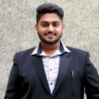
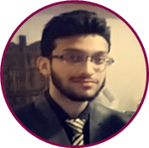
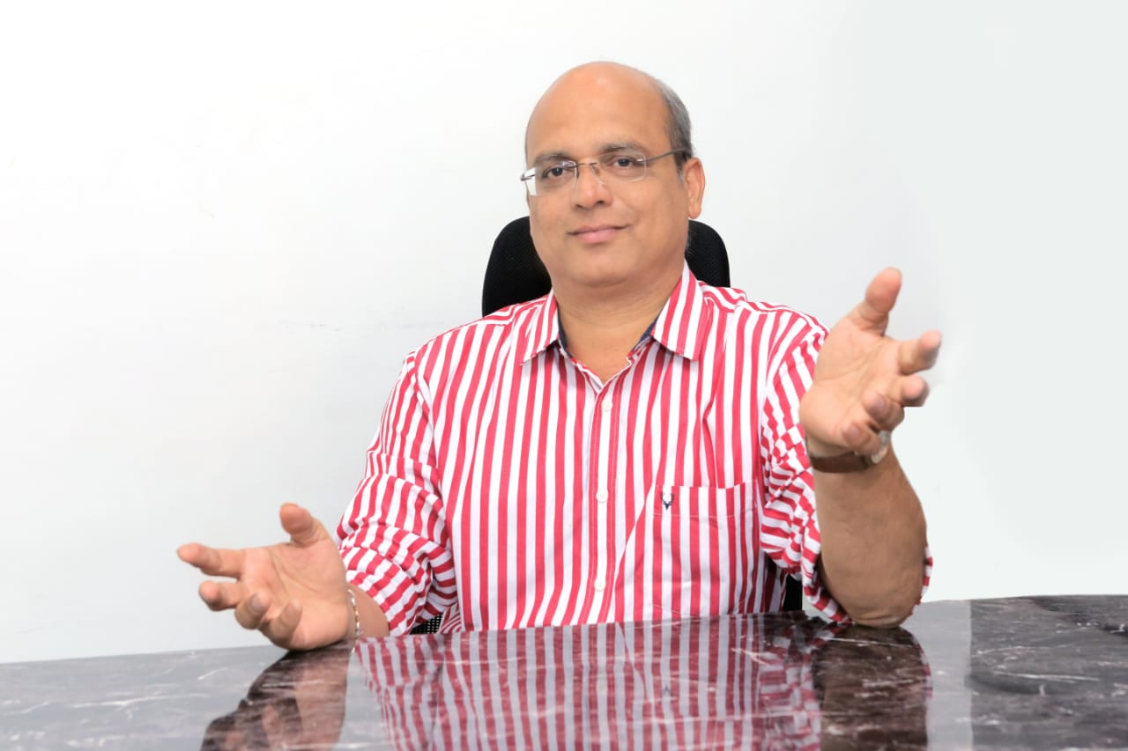

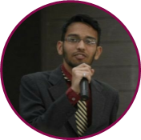
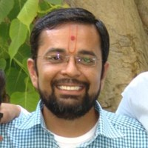
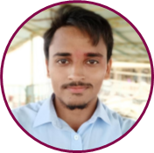
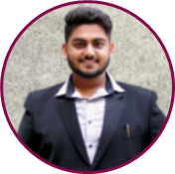
Mentors
Core Team
Hakimuddin Vohra
Dr Chintan Desai
BCA, MCA, Maharaja Sayajirao University
Android Developer @ KickStart
AR/VR Developer @ iTechnoSol
20+ Years of Experience
Clinical Hypnotherapist, Alternate Medicine Practitioner, Graphologist, AromaTherapist, Energy Healer.
Rukaiya Hetson
BA, Psychology, St Xavier’s College
MA, Counseling Psychology, MSU of Baroda.
Volunteer at MoodCafe.
Founder
Psychological Guidance
Hujefa Vohra
BCA, BabaSaheb Ambedkar University
Mobile Application Tester for Various firms.
Lead Psychologist
Dr Vishwas Raval
Uttam Prasad
Asst Professor at The Maharaja Sayajirao University of Baroda
PhD Smart Computing, Computer Vision, IoT.
MTech, IIT Roorkee
BCA, Maharaja Sayajirao University
Web Developer
CoFounder
Kunal Joshi
Technological Guidance
MSc Bio-Technology, Aribas, SP University
Owner at All India Marketing
Technical Head
Marketing Head

Slide 15
Go To Market Strategy
Awareness through Social Media platforms.
Roping in Real Life Warriors to come up and share their stories to the audience, being an ambassador for Mental Health
Videography on Mental Illness and its ignorance.
Arranging talks and seminars at different schools and universities.
Merchandising materials to retain and expand the community of listeners.
Roping in practicing psychologists to advertise and support.

Slide 16


DPIIT Certified Startup.
Incubated at Maharaja Sayajirao Innovation, Startup and Entrepreneurship Center (MSISEC), at The Maharaja Sayajirao University of Baroda
Featured in the Top 3 Innovative Startups under Mirchi Startup Express organized by CrAdLE and Radio Mirchi.
Received grant amounts from the likes of i-Hub under Startup Srujan program.
Received SSIP grant from Government of Gujarat.
Winner at Mera Startup Mahaan at Nirma University.
+91 84608 44958
befriendsapp@gmail.com
www.befriendsapp.in
Thank You
HAZHTeq Innovations Pvt Ltd

